Slide 1
1 Web and Graph
SPEAKER: NI Shijun

Slide 2
Content
Extract data from the Web: HTML retrieval, parsing, storing
Social network Graph

Slide 3
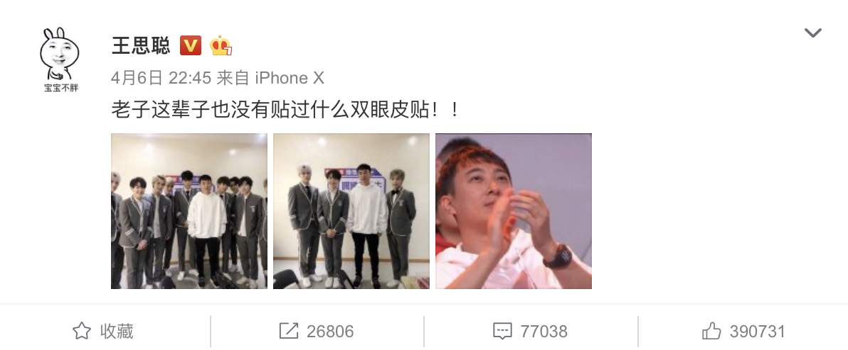
Question
What is the most efficient way to extract data from Sina Weibo?
Manual extraction --- just copy & paste from Browser ? Really?
What if you want to access thousands of webpages?

Slide 4
API
API --- Application Programming Interface
Interface designed by official web developers, users can access API and get the information they want easily.
Google, Facebook, Twitter, Weibo, … Many websites have their own API.
However, API has limitations: You Need Pay for the Service!!
Free users --- limited access opportunity for each day

Slide 5
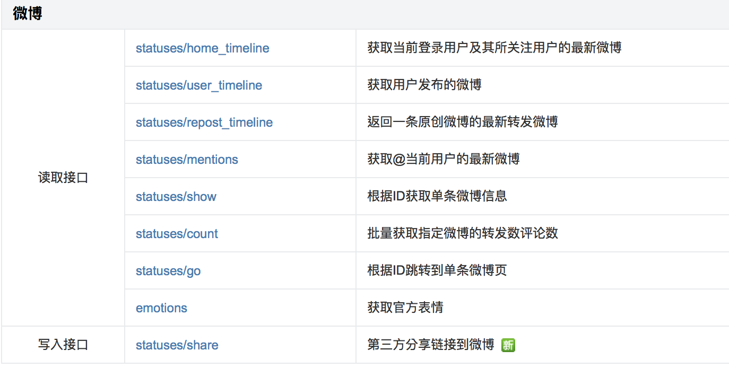
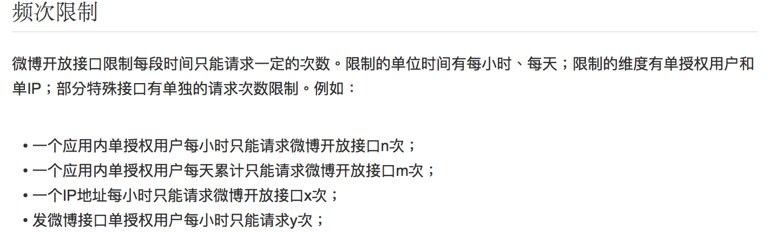

Slide 6
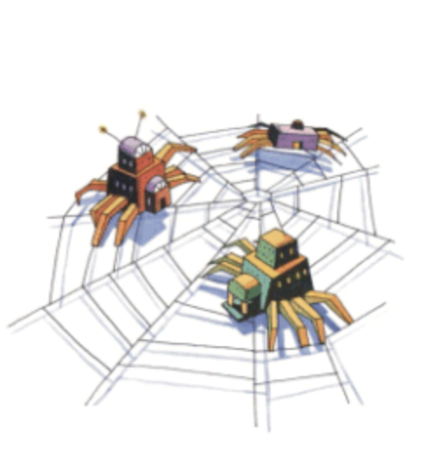
Web Crawler
A Web Crawler is a program that can extract ,parse and store data from websites to local memory automatically.
In this class, we will learn how to write a weibo web crawler.

Slide 7
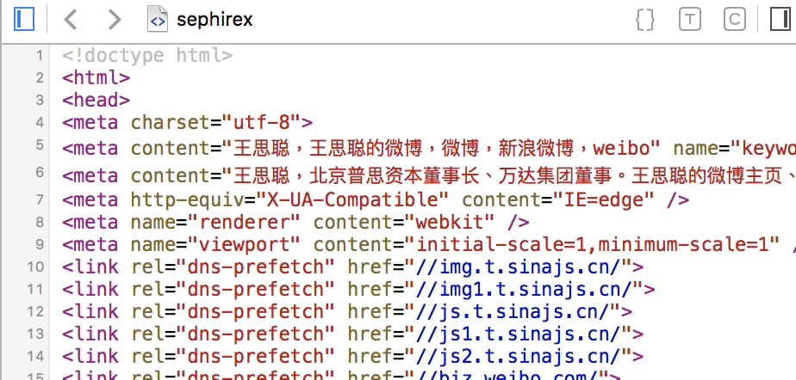
Web Basic: HTML
HyperText Markup Language (HTML) is the core language of nearly all Web content.
Most of what you see on screen in your browser is described, fundamentally, using HTML.

Slide 8
Web Basic: HTML
html
A markup language is a set of markup tags
Tree structure
<html>
<head>
<title>This is a title</title>
</head>
<body>
<h1>123456</h1>
<div>Text Example</div>
</body>
</html>
head
body
title
h1
div
This is a title
123456
Text Example

Slide 9
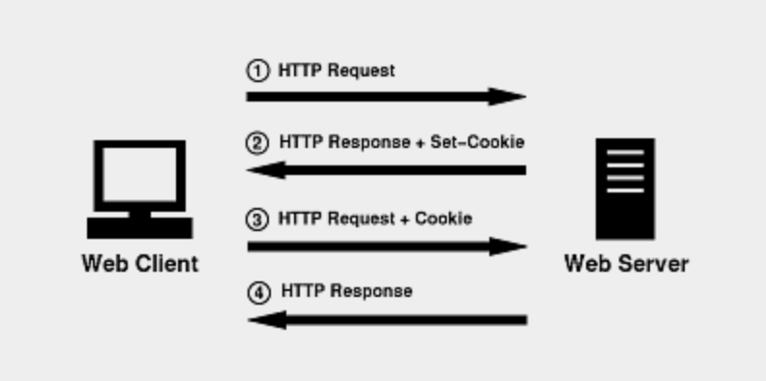
Web Basic: Cookie
An HTTP cookie is a small piece of data sent from a website and stored on the user's computer by the user's web browser while the user is browsing.
Once you login Weibo, your account information will be stored in Cookie so that the next time you will access Weibo without login twice
Each user will have different Cookie

Slide 10
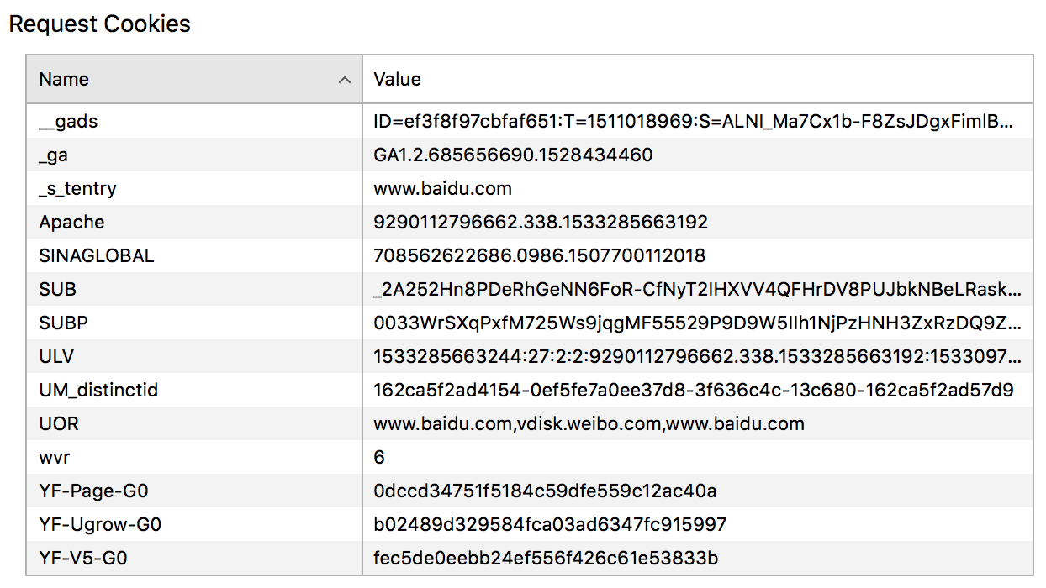
When we use web crawler to retrieve data, we can add our own Cookies into request
Without repeating login
Reduce the probability of being detected as a robot. ➔ limited response

Slide 11
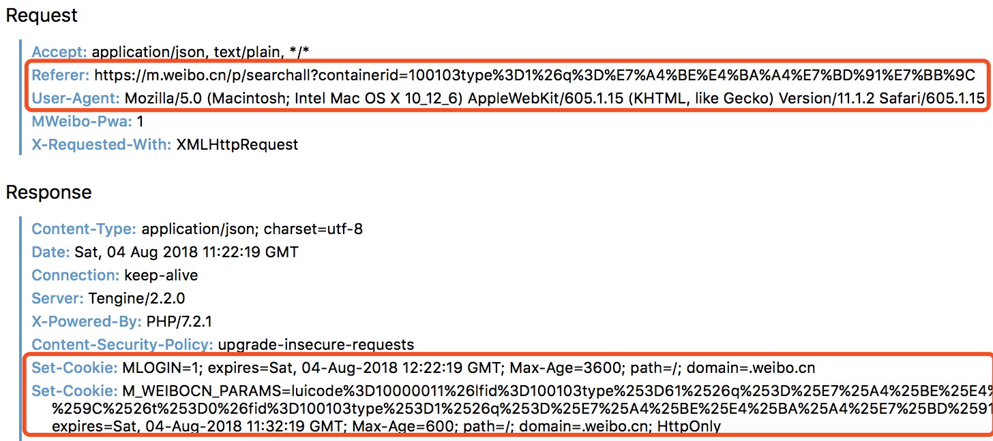
Codes
User_agent = “your user agent”
Referer =“your referer”
Cookie =”your cookie”
header=({'User-Agent': user_agent, 'Referer': referer, 'Cookie': cookie})
(for Safari: develop --- show source code --- network --- headers)

Slide 12
Web Basic: URL
URL --- Uniform Resource Locator(colloquially termed a web address), is a reference to a web source that specifies its location on a computer network and a mechanism for retrieving it.
https://weibo.com/ --- PC browser page
https://m.weibo.com/ --- Mobile browser page
https://weibo.cn/ --- WAP(Wireless Application Protocol) browser page
Usually, PC browser pages are more complex! ==> harder to find useful data
If possible, we choose mobile browser or WAP browser pages

Slide 13
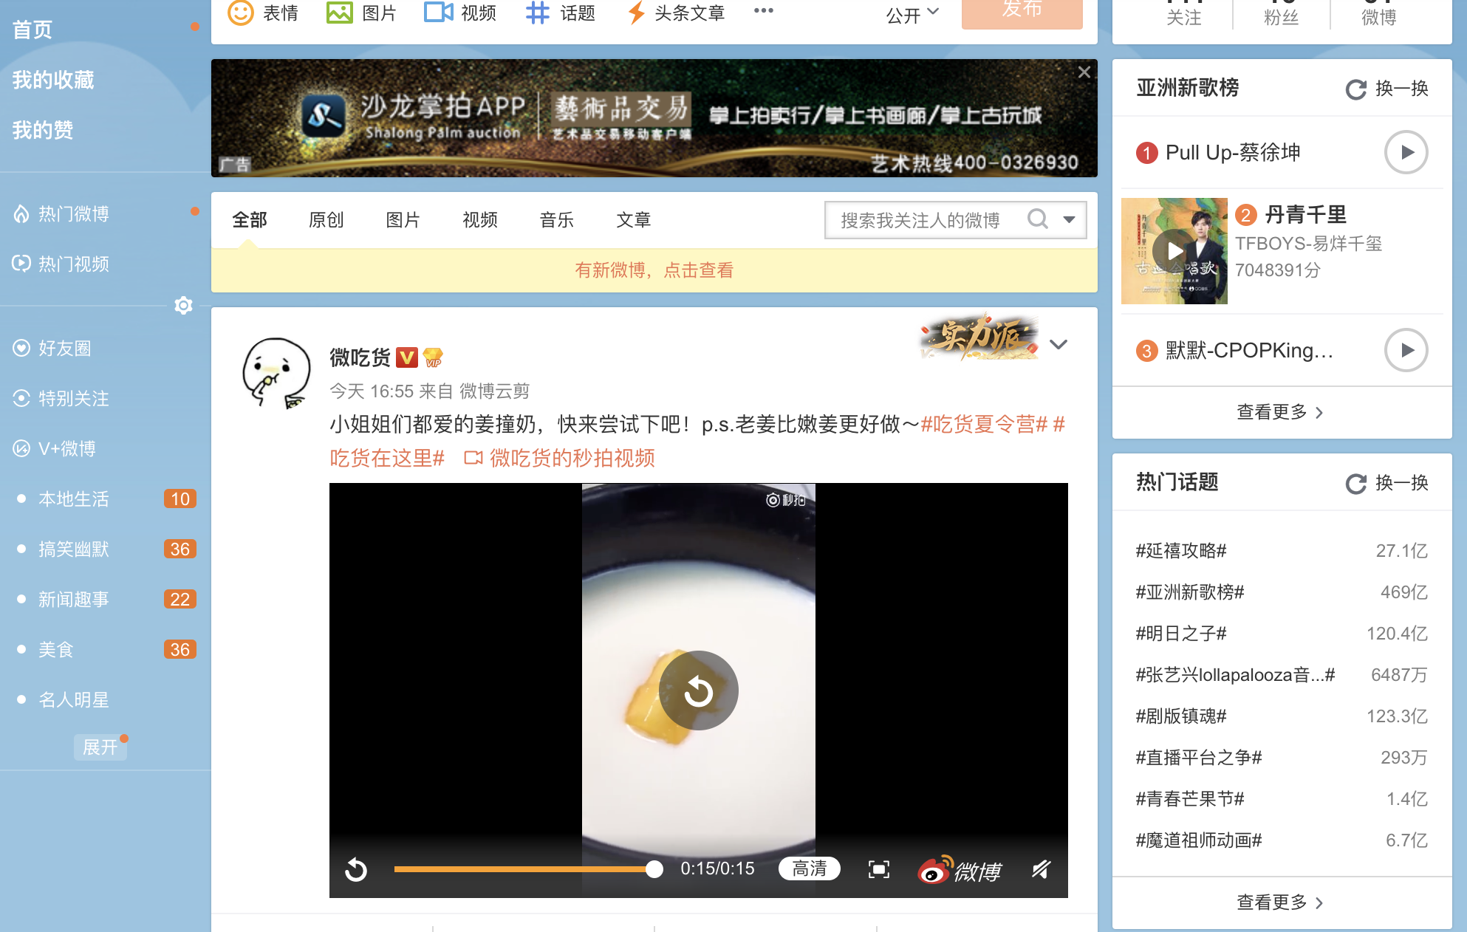
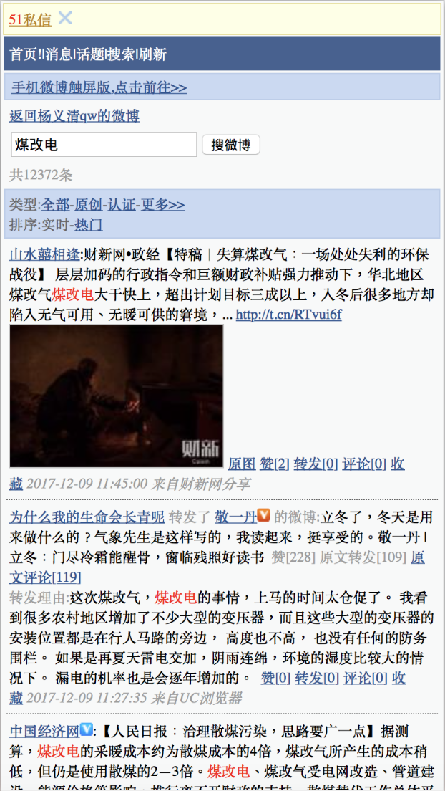
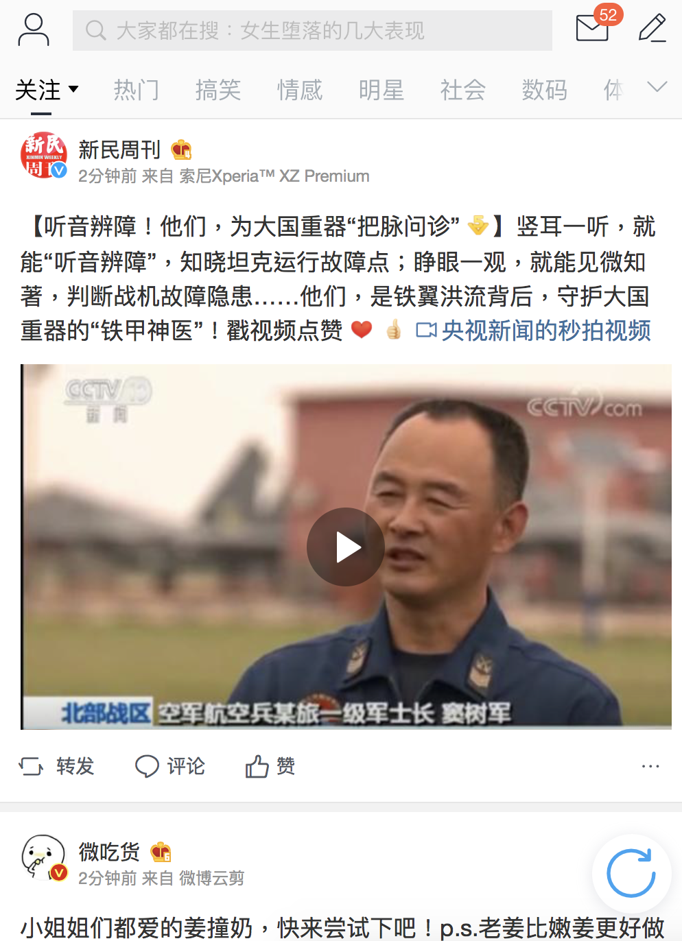

Slide 14
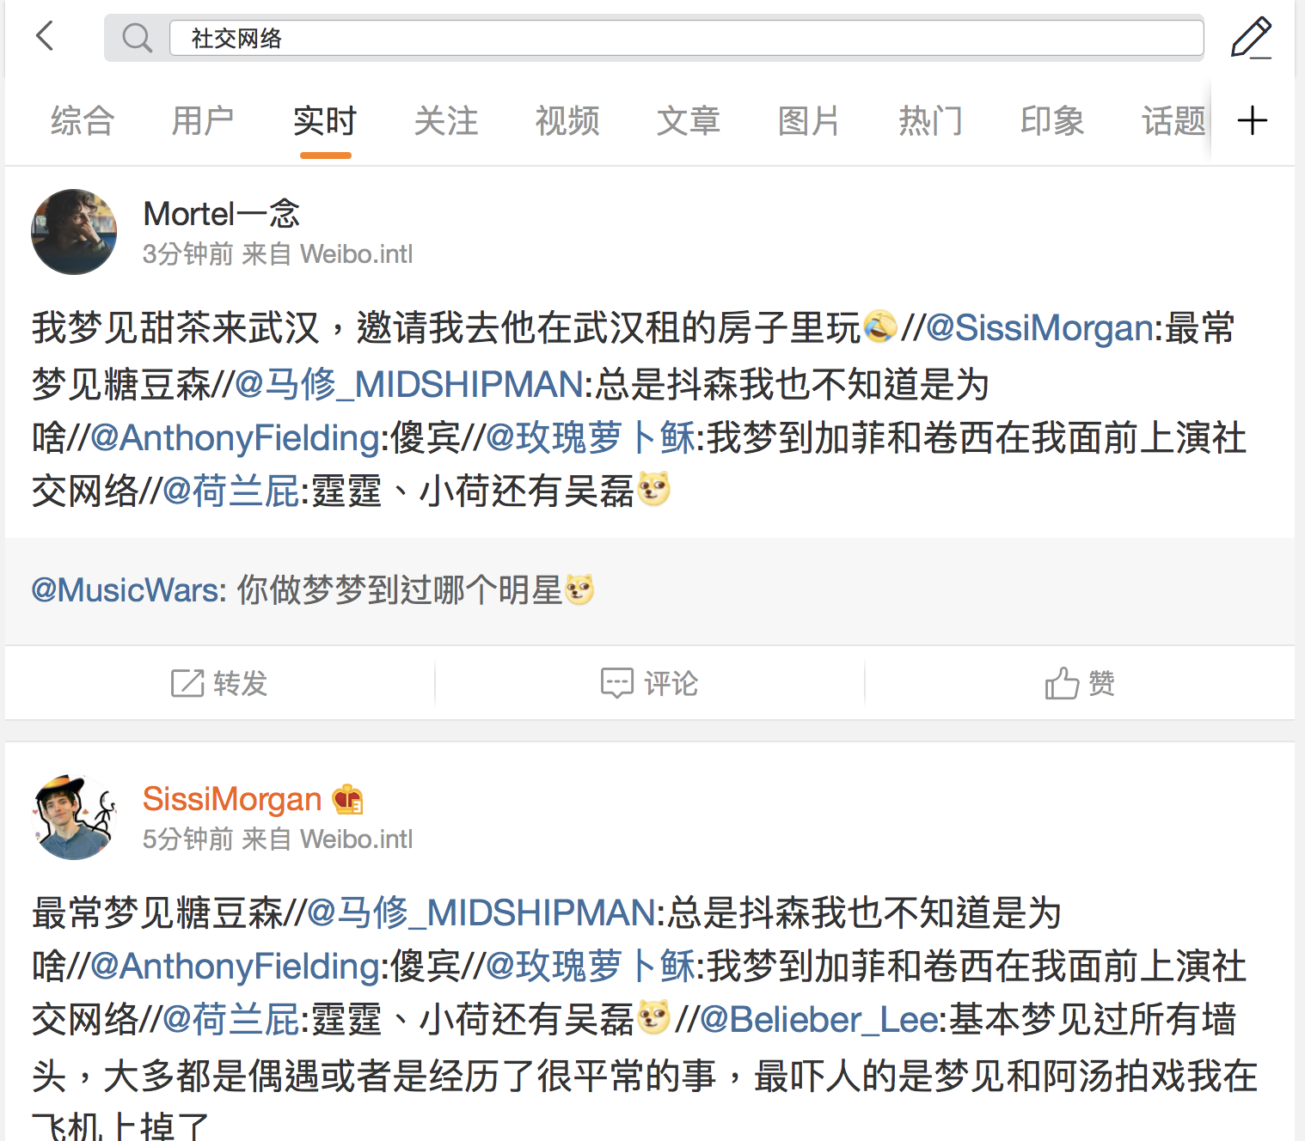
Extract data from mobile browser pages
In this part we will learn how to collect recent Weibo posts containing the term “社交网络”(Social Media Networks) from Mobile Sina Weibo

Slide 15
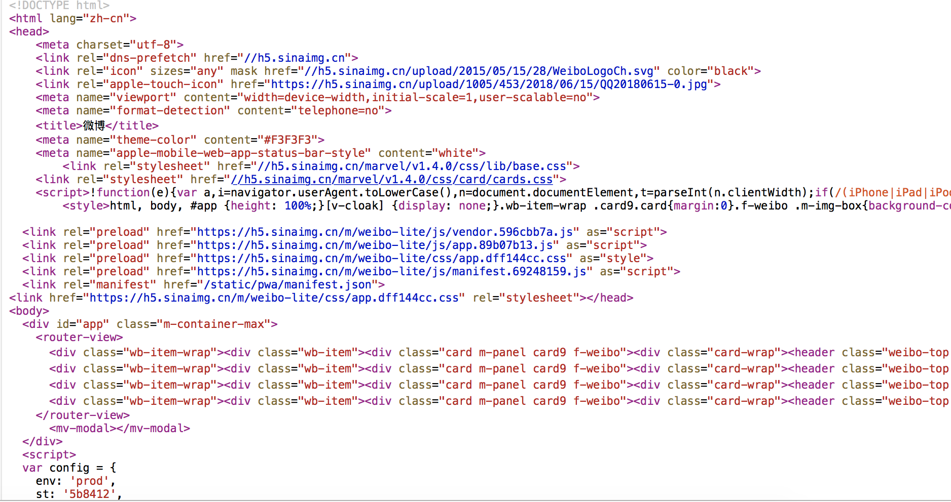
URL: https://m.weibo.cn/p/searchall?containerid=100103type%3D1%26q%3D社交网络

Slide 16
Web Basic: AJAX
We can see the HTML of the result page(for Safari, Develop—Show page source)
Just focus on Chinese text from HTML
However, we can not find any content related to the topic. WHY?

Slide 17
Web Basic: AJAX
AJAX --- Asynchronous JavaScript And XML
AJAX allows Web pages, and by extension Web applications, to change content dynamically without the need to reload the entire page.
Web page will request server get responses dynamically

Slide 18
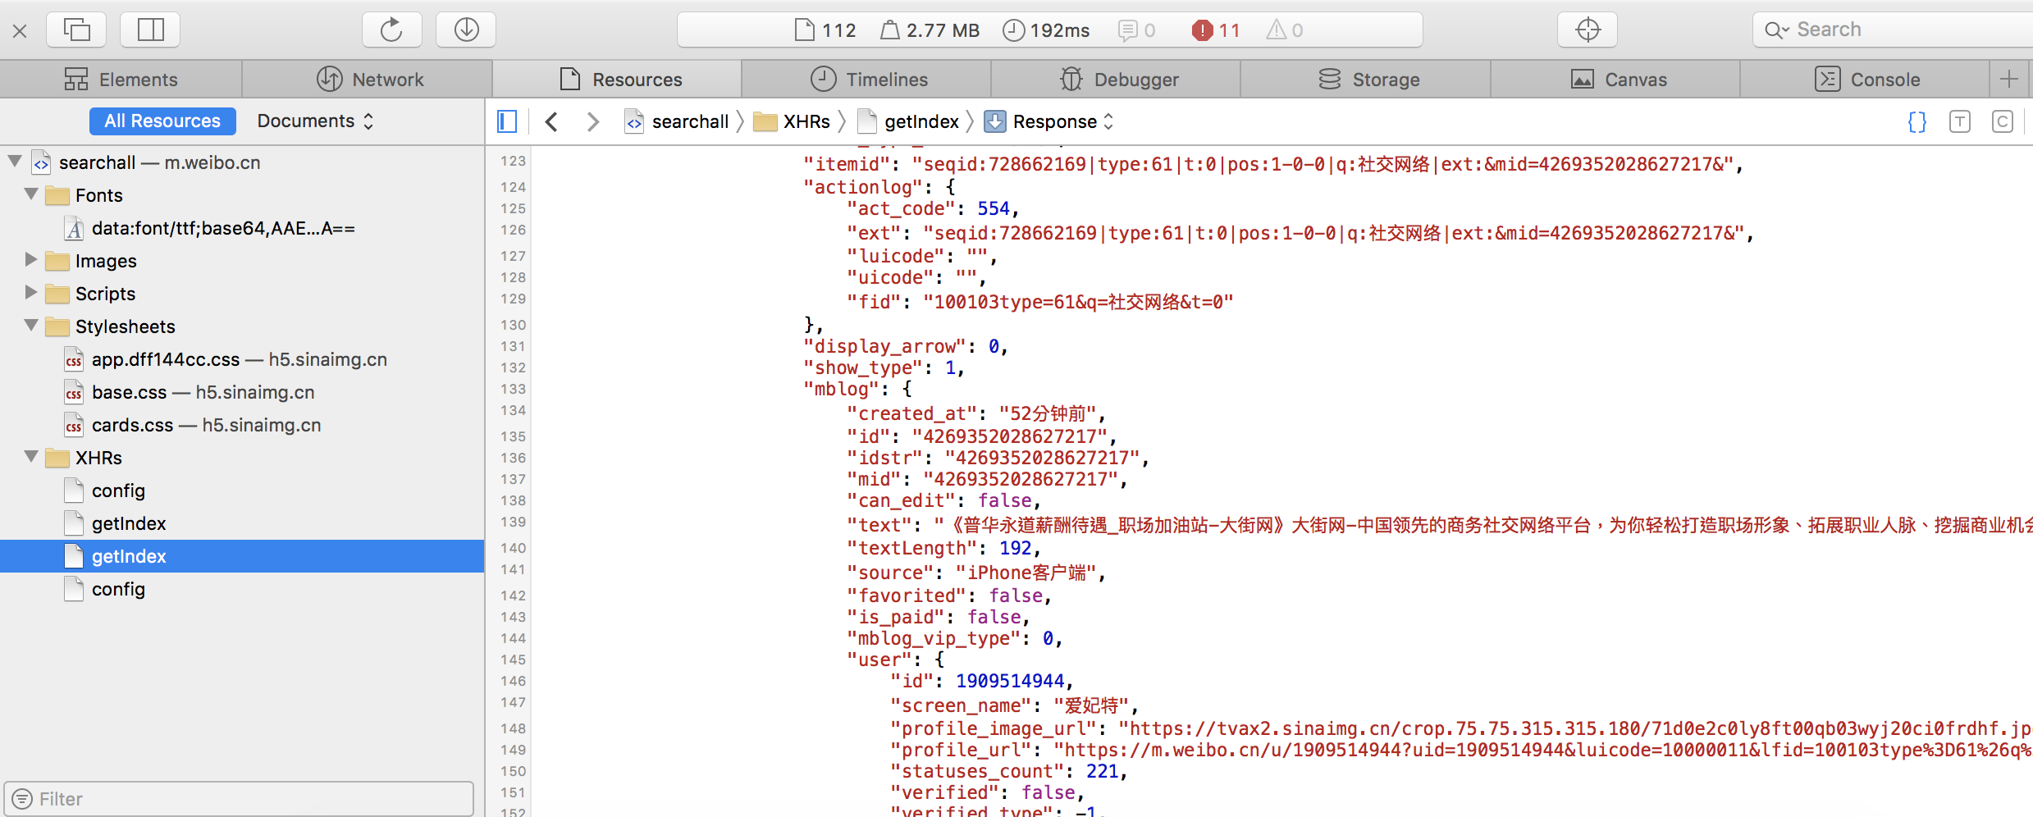
The response of “getIndex” is what we want!
URL of getIndex:
https://m.weibo.cn/api/container/getIndex?containerid=100103type%3D61%26q%3D社交网络%26t%3D0&page_type=searchall

Slide 19
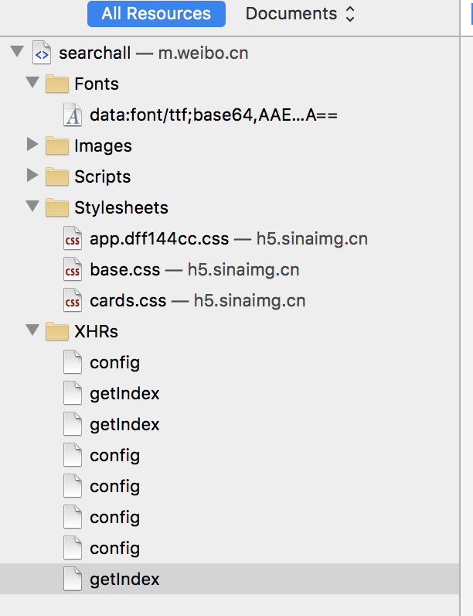
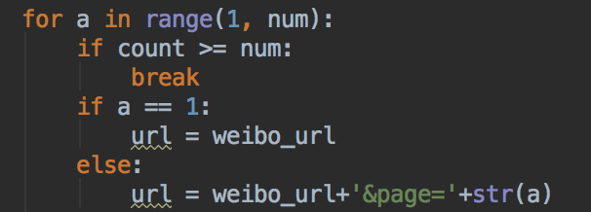
URL
However, here we only get the first page of data
Scroll down the page until the bottom, the page will dynamically request the server --- We get another new “getIndex” !
URL of the new “getIndex”:
https://m.weibo.cn/api/container/getIndex?containerid=100103type%3D61%26q%3D社交网络%26t%3D0&page_type=searchall&page=2
Nothing changes but an additional “&page=2”
Python codes:
url = “url of getIndex”
data = requests.get(url, headers=header, timeout=10)

Slide 20
Web Basic: JSON
The response data of getIndex is in JSON format
JavaScript Object Notation --- a very common data format used for asynchronous browser–server communication
Similar to dictionary in Python, but JSON only support “”, and type is String
”import json” --- import JSON library

Slide 21
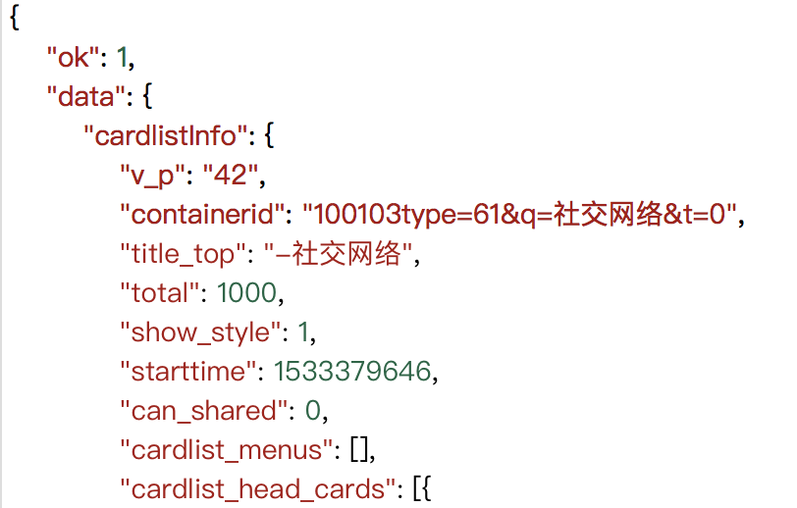
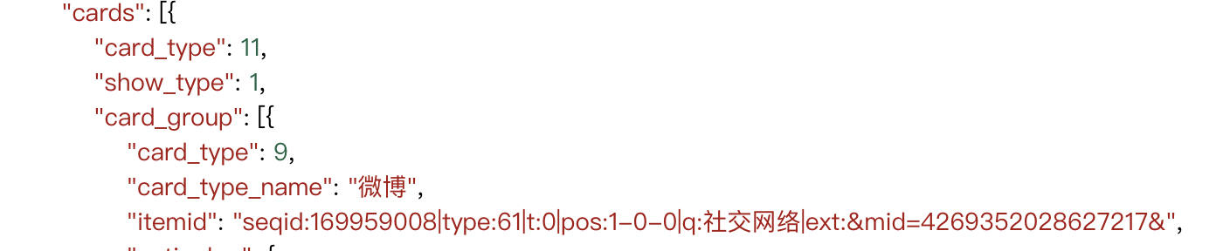
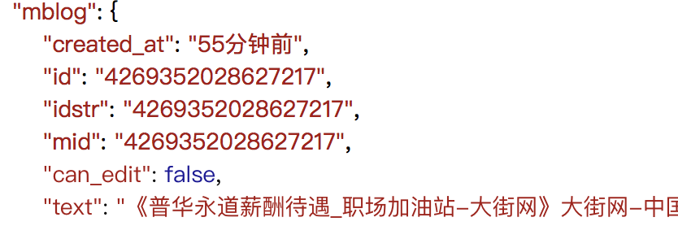
json_data = json.loads(data.text)
text = json_data['data']['cards'][0]['card_group'][1]['mblog']['text']

Slide 22
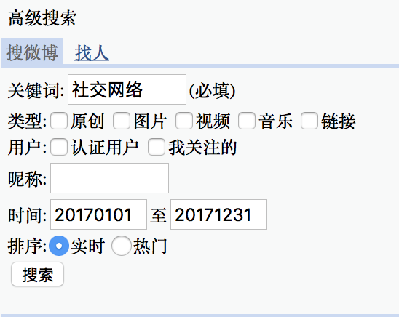
Extract data from WAP browser pages
What if we want to extract Weibo posts posted in 2017?
In Mobile Weibo, there is no advanced searching options
Advanced searching options in WAP browser pages:

Slide 23
Extract data from WAP browser pages
https://htmlformatter.com
Free online tool to format an ugly HTML code, making it readable and pretty, with the proper indentation.
Let’s look at the HTML of the result page:

Slide 24
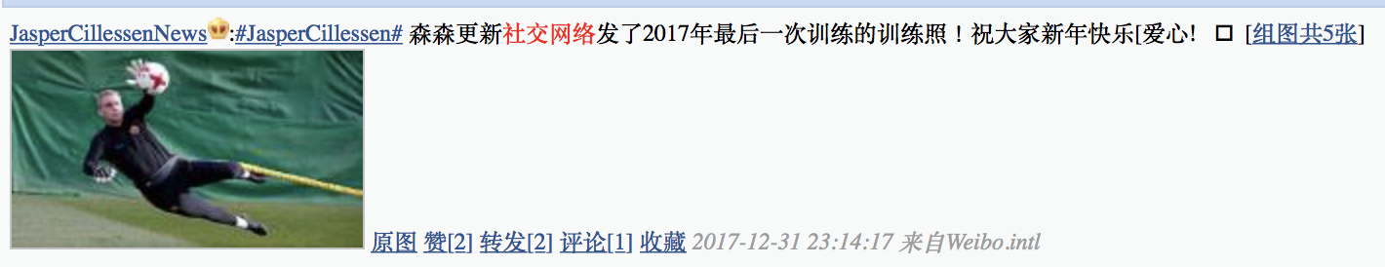
<div class="c" id="M_FCfq4FoRA"> <div><a class="nk" href="https://weibo.cn/u/6163761337">JasperCillessenNews</a><img src="https://h5.sinaimg.cn/upload/2016/05/26/319/donate_btn_s.png" alt="M" /><span class="ctt">:<a href="https://weibo.cn/pages/100808topic?extparam=JasperCillessen&amp;from=feed">#JasperCillessen#</a> 森森更新<span class="kt">社交网络</span>发了2017年最后一次训练的训练照！祝大家新年快乐[爱心]️ ​</span>&nbsp;[<a href="https://weibo.cn/mblog/picAll/FCfq4FoRA?rl=2">组图共5张</a>]</div> <div> <a href="https://weibo.cn/mblog/pic/FCfq4FoRA?rl=1"><img src="http://wx3.sinaimg.cn/wap180/006J8vTrly1fn0cw18pqfj30g0090ado.jpg" alt="图片" class="ib" /></a>&nbsp;<a href="https://weibo.cn/mblog/oripic?id=FCfq4FoRA&amp;u=006J8vTrly1fn0cw18pqfj30g0090ado">原图</a>&nbsp;<a href="https://weibo.cn/attitude/FCfq4FoRA/add?uid=5338089121&amp;rl=1&amp;st=63bb2c">赞[2]</a>&nbsp;<a href="https://weibo.cn/repost/FCfq4FoRA?uid=6163761337&amp;rl=1">转发[2]</a>&nbsp;<a href="https://weibo.cn/comment/FCfq4FoRA?uid=6163761337&amp;rl=1#cmtfrm" class="cc">评论[1]</a>&nbsp;<a href="https://weibo.cn/fav/addFav/FCfq4FoRA?rl=1&amp;st=63bb2c">收藏</a> <!---->&nbsp;<span class="ct">2017-12-31 23:14:17&nbsp;来自Weibo.intl</span></div> </div>

Slide 25
Beautiful Soup
Great! We have found the text we want from HTML
Beautiful Soup: a Python library for pulling data out of HTML and XML files
Some useful functions in Beautiful Soup:
get_text()
find_all()
find()

Slide 26
Beautiful Soup
get_text() : extracting all the text from a page
For example:
<span class="ctt">:<a href="https://weibo.cn/pages/100808topic?extparam=JasperCillessen&amp;from=feed">#JasperCillessen#</a> 森森更新<span class="kt">社交网络</span>发了2017年最后一次训练的训练照！祝大家新年快乐[爱心]️ ​</span>
soup.get_text()
result: #JasperCillessen#森森更新社交网络发了2017年最后一次训练的训练照！祝大家新年快乐[爱心]

Slide 27
Beautiful Soup
find_all() : looks through a tag’s descendants and retrieves all descendants that match your filters
For example:
<a href="http://example.com/elsie" class="sister" id="link1">Elsie</a>
<a href="http://example.com/lacie" class="sister" id="link2">Lacie</a>
<a href="http://example.com/tillie" class="sister" id="link3">Tillie</a>
soup.find_all(‘a’,{’class’:’sister’})
result: all these 3 tags could be found

Slide 28
Beautiful Soup
find() : looks through a tag’s descendants and retrieves the first descendants that match your filters
For example:
<a href="http://example.com/elsie" class="sister" id="link1">Elsie</a>
<a href="http://example.com/lacie" class="sister" id="link2">Lacie</a>
<a href="http://example.com/tillie" class="sister" id="link3">Tillie</a>
soup.find (‘a’,{’class’:’sister’})
result: <a href="http://example.com/elsie" class="sister" id="link1">Elsie</a>

Slide 29
Regular expression
A sequence of characters that define a search pattern for finding or replacing
import re
test_str = 'I like coke’
result = re.compile('coke')
print(result.findall(test_str))
output: ['coke']

Slide 30
Regular expression
test_str = 'I like coke 123’
result = re.sub("\D", "", test_str)
print(result)
output: 123

Slide 31
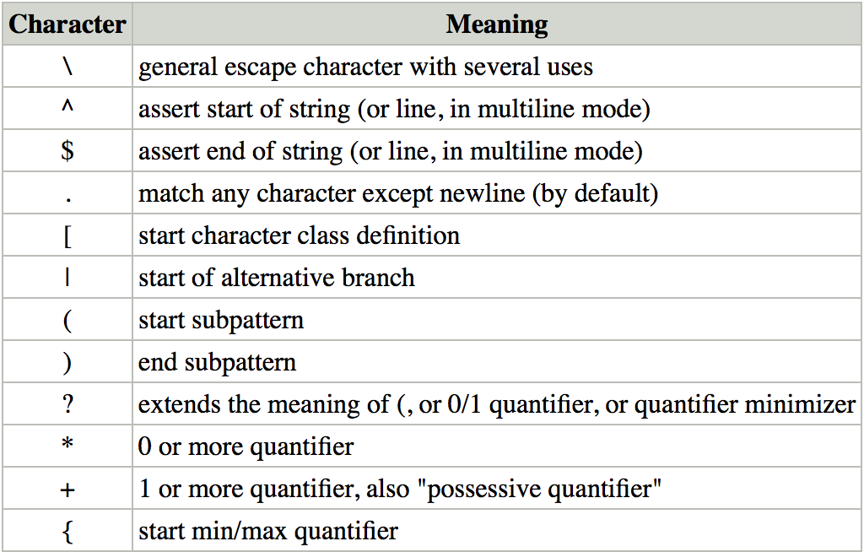
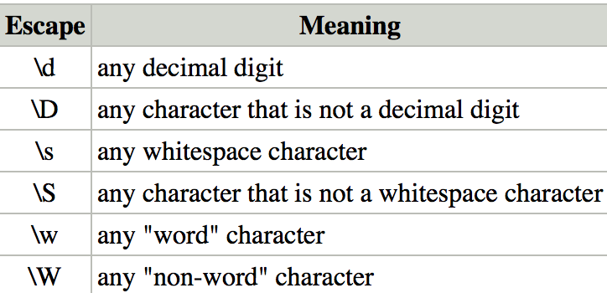
Regular expression
The syntax of RE can be very complex, here are some examples:
If you want to learn more, click https://www.w3cschool.cn/zhengzebiaodashi/regexp-syntax.html

Slide 32
URL
URL of the result page 1
https://weibo.cn/search/mblog?hideSearchFrame=&keyword=社交网络&advancedfilter=1&starttime=20170101&endtime=20171231&sort=time&page=
URL of the result page 2
https://weibo.cn/search/mblog?hideSearchFrame=&keyword=社交网络&advancedfilter=1&starttime=20170101&endtime=20171231&sort=time&page=2
Same as the mobile Sina Weibo pages

Slide 33
Data Storing
Usually, we store data in .csv format
In Pandas, to_csv() is a very useful function to save data as a .csv file
to_csv(file path, encoding="utf_8_sig", mode='a+', index=False, header=False)

Slide 34
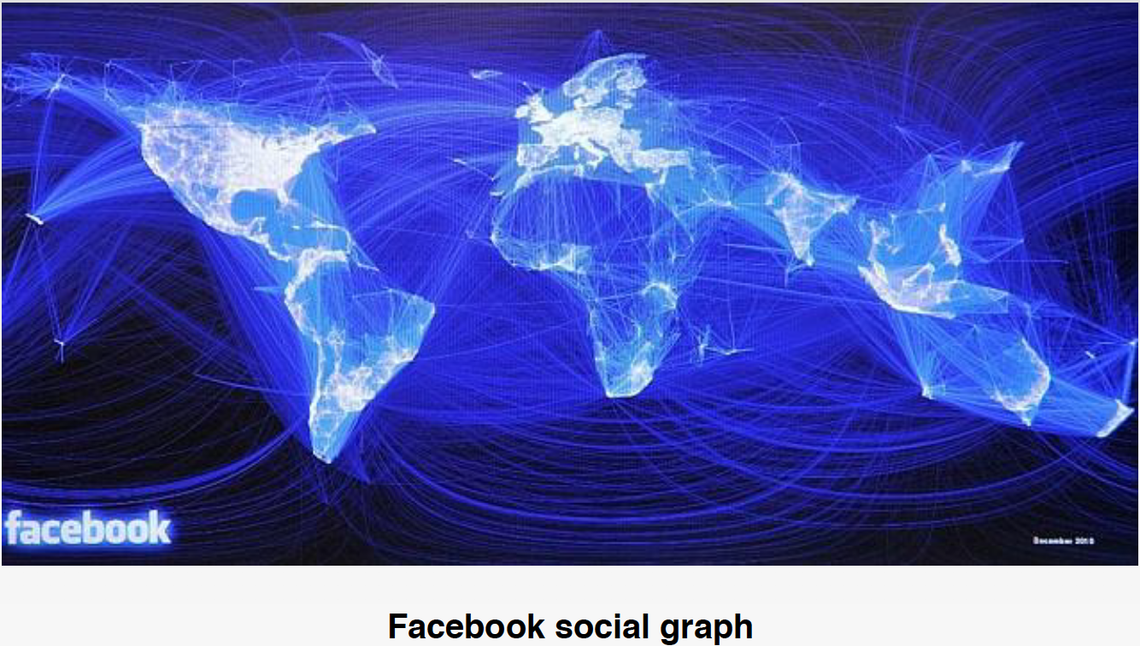
Graph Theory

Slide 35
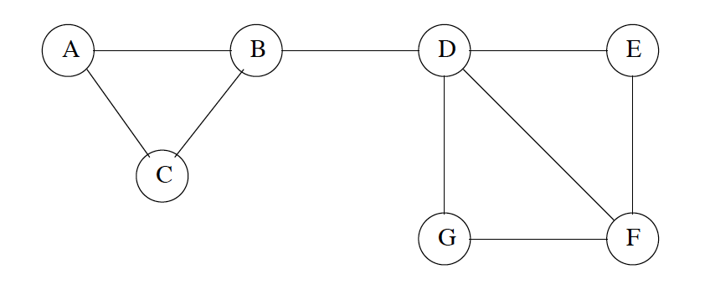
Social Network Graph
There is much information to be gained by analyzing the large-scale data that is derived from social networks.
“Friends” networks
Followers networks
…
We can use “Graph” to represent social networks such as friends relation.

Slide 36
Graph
How to represent graph data in the computer?
A graph G = (V, E)
V = set of vertices (nodes)
E = set of edges
G can be directed or undirected:
Directed graph --- edges in E have direction
Example: (u,v) means u->v, while (v,u) means v->
Undirected graph --- edges in E have no direction
Example: (u,v) and (v,u) are the same

Slide 37
Directed vs Undirected
1
2
1
2
3
4
3
4
Directed Graph:
V = {1,2,3,4}
E = {(1,2),(1,3),(1,4),(4,1),(4,3)}
Undirected Graph:
V = {1,2,3,4}
E = {(1,2),(1,3),(1,4),(3,4)}
Vertices connected with edge are neighbors:
Directed: (1,3) --- 1 is in-neighbor of 3, 3 is out-neighbor of 1
Undirected: (1,3) --- 1 is neighbor of 3, 3 is neighbor of 1

Slide 38
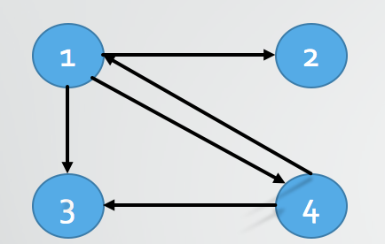
Representing Graphs
In Computer Science, there are two ways to represent graphs:
adjacency matrix
A n x n matrix M, M[i, j] = 1 if edge (i, j) (or weight of edge)
= 0 if edge (i, j)
 | 1 | 2 | 3 | 4
1 | 0 | 1 | 1 | 1
2 | 0 | 0 | 0 | 0
3 | 0 | 0 | 0 | 0
4 | 1 | 0 | 1 | 0

Slide 39
Representing Graphs
In Computer Science, there are two ways to represent graphs:
adjacency list
Only take 1 in adjacency matrix and ignore 0
 | 1 | 2 | 3 | 4
1 | 0 | 1 | 1 | 1
2 | 0 | 0 | 0 | 0
3 | 0 | 0 | 0 | 0
4 | 1 | 0 | 1 | 0
1: 2,3,4
2:
3:
4: 1,3

Slide 40
Graph Exploration
If we want to explore every vertex and every edge in a graph, where should we start?
Two well-know methods:
BFS --- Breadth-first Search
DFS --- Depth-first Search

Slide 41
Breadth-first Search
Explore the graph and transform graph to a tree:
Pick a source vertex to be the root
Find root’s all children
Then pick a child of root’s all children, find its all children
…

Slide 42
Depth-first Search
Explore the graph and transform graph to a tree:
Pick a source vertex to be the root:
Step1: Find and pick a child of root
Step 2: Find and pick a child of the child of root
…
Step 3: Until can not find a child, then go back to previous child, repeat step 1

Slide 43
Shortest Path
1
1
2
6
3
6
3
4
2
Edges can have distance (or weights, costs)
How to find a shortest path from source to target node?
Dijkstra’s Algorithm: For a given source node in the graph, the algorithm finds the shortest path between that node and every other nodes

Slide 44
Properties of Social Network Graphs
Locality
A graph exhibits locality if when there is an edge from x to y and an edge from y to z, then the probability of an edge from x to z is higher than one would expect given the number of nodes and edges in the graph.
X is a friend of Y and Z, then Y and Z have high probability to be friends
Small-world property
Many very large graphs have small diameter(maximum distance between two nodes).
6 degrees of Kevin Bacon. Any two people on Earth are six or fewer acquaintance links apart.

Slide 45
Community
Social networks contain communities of entities that are connected by many edges
Community= set of nodes with an unusually high density of edges
How to identify communities?

Slide 46
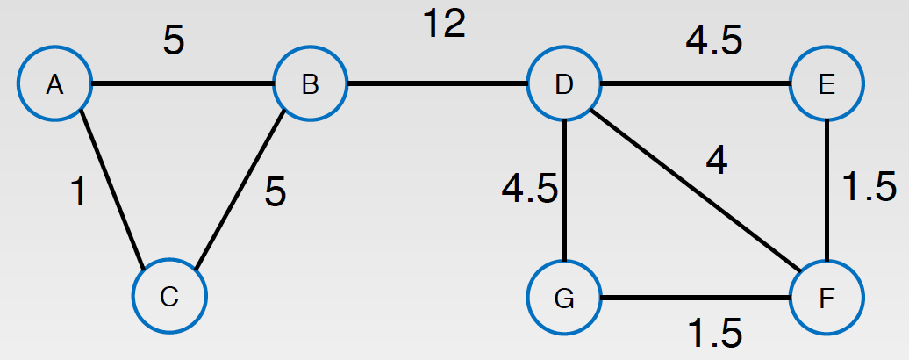
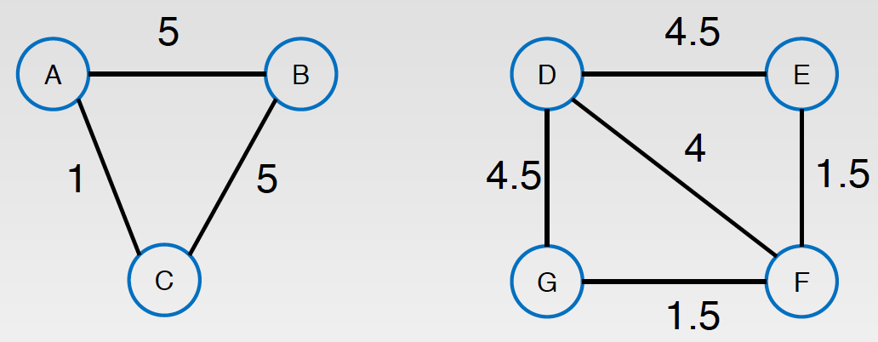
Betweenness
For every pair of vertices, there exists at least one shortest path between the vertices such that either the number of edges that the path passes through (for unweighted graphs) or the sum of the weights of the edges (for weighted graphs) is minimized.
The betweenness centrality for each vertex is the number of these shortest paths that pass through the vertex.
Edges of high betweenness can separate communities
The Girvan-Newman Algorithm --- compute betweeness

Slide 47
Cliques
Dad
Mom
Son
Cliques = sets of nodes that are fully connected( with edges between any two of them).
Example: a family(Mom, Dad, Son) in facebook can be a 3-clique
We can grow a community from a clique by adding nodes
Prefer nodes that add more edges
Keep the fraction of possible edges that are present suitably high

Slide 48
Alan
John
Dad
May
Mom
Son
Start with {Dad, Mom, Son} (3-clique)
Set threshold = 0.65
Add John, fraction of edges = 5/6 = , better than May, while fraction = 4/6 =
Why 6?
Now community = {Dad, Mom, Son, John}
Add Alan, fraction = 6/10=0.6 < 0.65, too low

